Slide 1


LEAD
GENERATOR
Presented by:
Murtaza Khalid (FA20-BSCS-0108)
Qurat ul Ain Zehra (FA20-BSCS-0119)
Syed Shaheer Qamar (FA20-BSCS-0015)

Slide 2

BACKGROUND
Bridge the gap between businesses struggling to track potential customers and consumers searching for the right products within their budget and preferences.

Slide 3



PROBLEM SATEMENT
Develop a system for efficient lead generation and simplified product discovery to boost sales, enhance marketing strategies, and save time for both businesses and customers.

Slide 4


SIGNIFICANCE
We're enabling businesses to connect with potential customers swiftly, improving their sales and profits through technology-driven efficiency. This project saves time for all involved and fuels innovation in lead management.

Slide 5




PROPOSED SOLUTION
Develop a system to streamline the discovery, organization, and communication between businesses and potential customers, enhancing sales and marketing while simplifying the shopping experience for customers, resulting in a mutually beneficial and efficient connection.

Slide 6





COMPETITORS

Slide 7


METHODOLOGY
Employ the Agile methodology to efficiently handle the project, given its multifaceted nature. Agile offers flexibility, adaptation to evolving requirements, collaboration, continuous feedback, and incremental product delivery.

Slide 8

FEATURES
1
Push Notifications
Scam Prevention Ranking
2
3
Vulgar Request Filtering via NLP
Points-Based Payment Gateway (Tentative)
4
5
User-Friendly Interface
Secure Application with Two-Factor Authentication and JWT token
6
7
User Reviews and Ratings
Faster Response Times
8
May
9
Seller Bidding
.Messaging Service
10

Slide 9
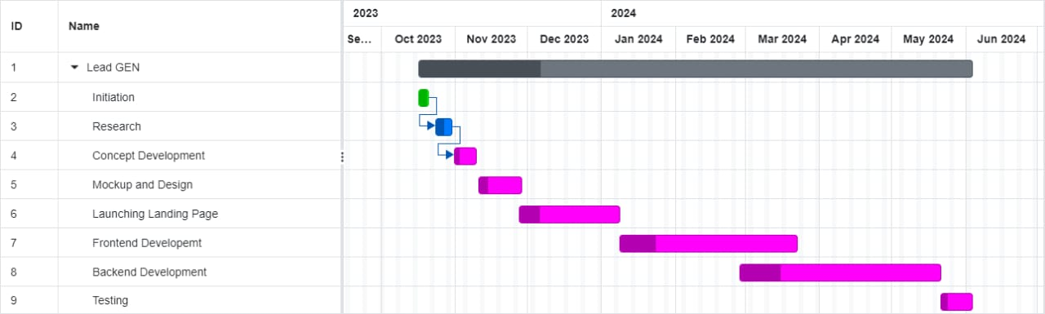
GANTT CHART

Slide 10

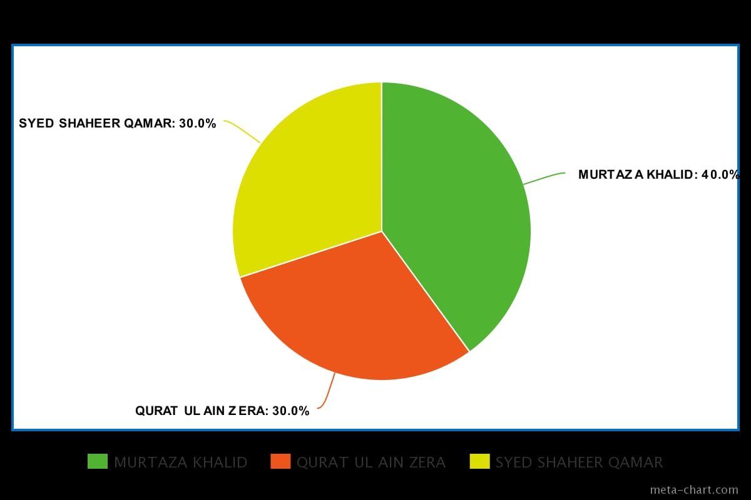
PROJECT
DISTRIBUTION

Slide 11

POTENTIAL USERS
All types of business and customers

Slide 12
Thank You

